Slide 1

MicaRiYa Real Estate
Real Estate Simplified

Slide 2
Brief History of Our Work
Each group member chose one d-i-y real estate website to thoroughly analyze. The sites chosen were, Zillow.com, Fairsquare.ca and Realtor.ca.
Produced HTA and KLM models of Zillow, FairSquare, and Realtor
Designed and distributed a survey on the real estate process
Decided that of the three websites analyzed, Zillow was the best and would be our guide/standard
Designed personas based on our survey feedback
Created a rough template based on our primary persona using Zillow as a guide
Implemented the template, making a few minor changes and additions
Edited the website based on our peer-review feedback

Slide 3
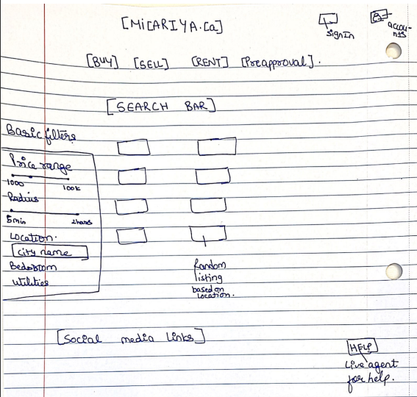
Initial Design

Slide 4
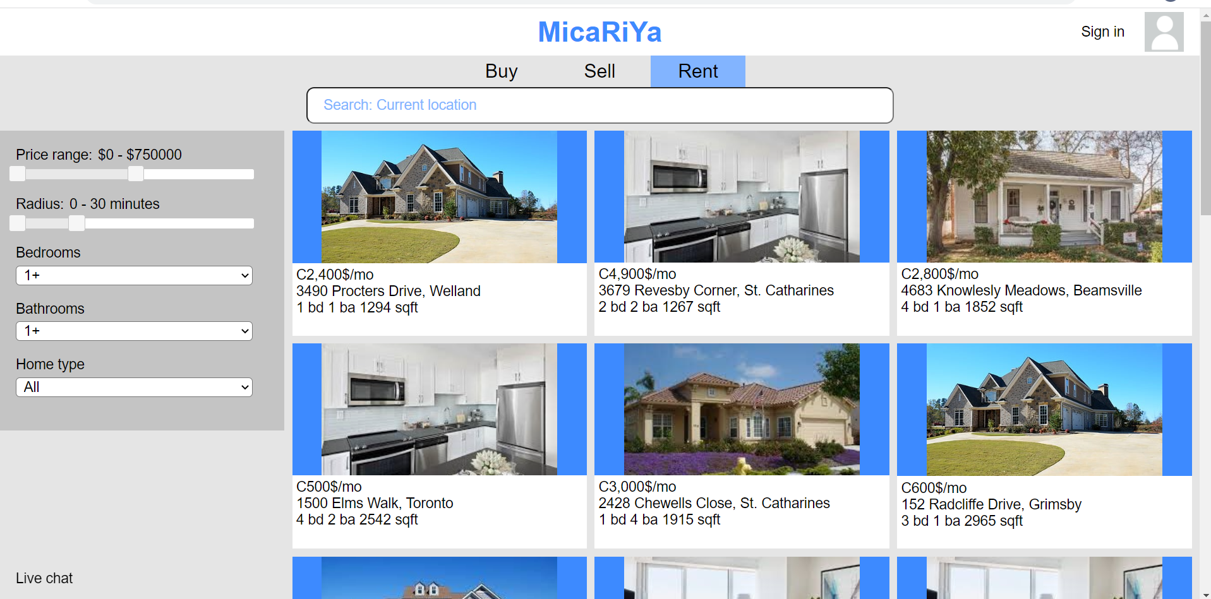
Stage 2 Design

Slide 5
User Group Description
In our research, we found three major categories of users:
First time buyers
Repeat buyers
Renters

Slide 6
First Time Buyer Description
Younger age: usually in their 20’s to 30’s
Shifting demographic: higher real estate prices means less young people are in the category
Stage of life: just married or upgrading from a rented apartment
Goals: often price-centric, location is not always a big concern
Worries: finding a place to buy, especially with the high prices and hot market

Slide 7
Repeat Buyer Description
Higher age: usually mid 30’s and up
Stage of life: often a family with children, older generation looking to downgrade
Focus: on buying the new house, not on selling the old
Goals: price is not as important here
Usually one or two characteristics of the new house are most important
eg. location, number of bedrooms, or property size
Worries: quality of the new house compared to the old, finding a new house

Slide 8
Renter Description
Younger age: late teens to mid 20’s
Shifting demographic: people in their late 20’s and early 30’s are becoming more common
Stage of life: going to college/university or just married
Goals: often location and price-centric
Worries: finding a good place to rent with the least amount of stress

Slide 9
Primary Persona Summary
Jeff Davis: repeat house buyer
32 years old, married, three young children
Wants a house with a big yard
Would like the process to go quickly and smoothly; he does not have a lot of free time
Major Insights:
Focus on simplicity and efficiency
Concentrate efforts on the buy page, not the sell page

Slide 10
Our Assumptions
Focusing on simplicity will lead to better usability for the primary persona
eg. Try to use menus sparingly, if at all
Less actions per task is better
The primary persona is familiar with websites like eBay and Amazon
Therefore, the primary persona has decent computer literacy
Aim for the Ontario real estate market

Slide 11
Changes We Implemented
The site is visually busy when opening for the first time
Added an index page
Search bar goes straight to "Buy" page
The house profiles are visually distracting
Darkened and dulled the main website colours
The site lacks design/grouping on the header
Changed header and button design and moved the search bar

Slide 12
Changes We Implemented
The profile logo does not lead to the “Account” page
Removed profile logo, it is pointless
The “Buy” and “Rent” page reload when you click on their corresponding buttons, even if they are already loaded
Removed the glitch, this was not intended
There is no place for landlords to rent their property
Changed "Sell" page to "List"
Added rent option on "List" page

Slide 13
Changes We Implemented
There is very little information available for the listings
Added "House Listing" page able to fit more information
The bedroom and bathroom abbreviations are not the standard
Changed abbreviations to the standard according to http://www.nolo.com/sites/default/files/Abbreviations.pdf
The price format on the listings is not the standard
Changed the format to the Canadian standard
There is no way to contact the sellers
Added contact info on the "House Listing" page

Slide 14
Changes We Implemented
There is no way to go back to a placed offer
There was a way to do this (the "Account" page), but it was less finished compared to other pages
Rebuilt "Account" page with all of the intended functionality
There is no way to bookmark a house
Added favorite icon to "House Listing" page
Added Your Bookmarked Properties to the "Account" page
There are no maps of the surrounding area
Added Google Maps image to available images on "House Listing" page

Slide 15
Changes We Implemented
The maximum house price search criteria is too low
Average Ontario house price (as of April 2022) is $1,052,920 according to https://wowa.ca/ontario-housing-market
Changed maximum from $1.5 million to $2 million
Primary persona is middle class
Renting prices are typically not negotiable
Added negotiable option on "List" page

Slide 16
Changes We Implemented
There is no feedback suggesting you can click on the house pictures
The mouse icon does change to a hand pointer, but we also added a pop effect
The house pop-up is visually distracting due to the lack of change in the background
Added "House Listing" page which automatically opens up in a new tab
Users would not want to sign up for another website (partnership with LoopNet)
Added automatic LoopNet account creation when link is clicked

Slide 17
Changes We Did Not Implement
There is nothing indicating that the "Live Chat" link can be clicked
The mouse icon changes to a hand pointer, indicating that the link can be clicked
If someone wants to open a live chat, they will start by exploring the "Live Chat" link
Otherwise, the link stays out of the way for those who do not need it
The radius should be in kilometres, not minutes
Minutes is way more useful than km (eg. Toronto vs Welland)
Google Maps already offers this feature

Slide 18
Changes We Did Not Implement
Site should not have option to buy from real estate agent
Our site has the option to sell, not buy, with a real estate agent
This allows people to have a real estate agent handle the listing details
User research indicates that what people appreciate most about real estate agents is when they handle these details
Site needs icons
Would probably end up adding to the clutter
Instead focused on simplifying/cleaning up the interface

Slide 19
Changes We Did Not Implement
Site should have a section explaining how the DIY real estate market works
Instead, we focused on making a website that is simple and intuitive to use
Tried to match the user's cognitive model of the real estate market
Organized website similar to eBay or Amazon
Site should have a site map
The header leads to all pages of the site and is always visible

Slide 20
Changes We Did Not Implement
Search bar must give an exact location for the radius to work
Our assumption was that the search bar would work like the one on Google Maps

Slide 21
Future Work
Make mobile-responsive design
We concentrated on a desktop screen design
We thought the primary persona would perform a more complicated task like buying and selling a house on a desktop
We also lacked time and experience to create a decent responsive site
Do more user research on search filters
What are people looking for?
We have a good start, but it could be better

Slide 22
Thank You

